Slide 1
Web Development using React js
Sharmake Ali Kahie
Lecturer
Faculty of Computer & IT
Jamahiriya University of Science & Technology
kahie@just.edu.so

Slide 2
Chapter #6
Bootstrap
useContext
useRef
Bootstrap

Slide 3
Bootstrap
Bootstrap is a free front-end framework for faster and easier web development
Bootstrap includes HTML and CSS based design templates for typography, forms, buttons, tables, navigation, modals, image carousels and many other, as well as optional JavaScript plugins
Bootstrap also gives you the ability to easily create responsive designs

Slide 4
Bootstrap
Bootstrap is the most popular HTML, CSS, and JavaScript framework for developing responsive, mobile-first websites
Now that Bootstrap 5 no longer requires jQuery, using it in your React app is much easier and without conflicts Now that Bootstrap 5 components are written as vanilla JS plugins, you get improved alignment with React's best patterns & practices.
This also means it's possible to use Bootstrap 5 components without the need for a 3rd party library like react-bootstrap or reactstrap

Slide 5
Method to Add Bootstrap to React
First up, add Bootstrap to your React app's package.json
npm install bootstrap –save
There are mainly three ways to add Bootstrap to the React app. We will discuss them one by one.
Using Bootstrap CDN.
Import Bootstrap in React as a dependency
Install React Bootstrap package (such as bootstrap-react or reactstrap)

Slide 6
Bootstrap CDN
This is one of the easiest ways to use bootstrap in your React app. The best thing about bootstrap CDN is no requirement for installation or downloads. You just need to copy and paste a link in the head section of your app to make it work. Below is the link that you need.
<link rel="stylesheet" href="https://stackpath.bootstrapcdn.com/bootstrap/4.1.0/css/bootstrap.min.css" integrity="sha384-9gVQ4dYFwwWSjIDZnLEWnxCjeSWFphJiwGPXr1jddIhOegiu1FwO5qRGvFXOdJZ4" crossorigin="anonymous">

Slide 7
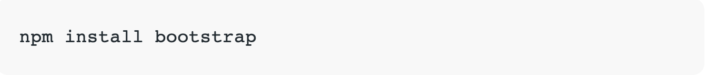
Import Bootstrap as a Dependency
You might have used some module bundler or webpack in your application or you might have heard these names. This one is another option to add bootstrap to your React application. You can run the command given below and install bootstrap as a dependency in your application.

Slide 8
Import Bootstrap as a Dependency
You might have used some module bundler or webpack in your application or you might have heard these names. This one is another option to add bootstrap to your React application. You can run the command given below and install bootstrap as a dependency in your application.

Slide 9
Install React Bootstrap Package
The other method to add bootstrap in your React component is adding a package with the inbuilt bootstrap component. These are designed to work with your React application components. Below is the name of two popular packages.
react-bootstrap
Reactstrap
Both are good choices for using Bootstrap with React apps
npm install react-bootstrap bootstrap

Slide 10
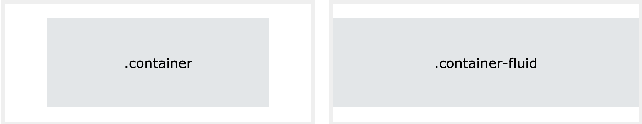
Bootstrap 5 Containers
Containers are used to pad the content inside of them, and there are two container classes available:
The .container class provides a responsive fixed width container
The .container-fluid class provides a full-width container, spanning the entire width of the viewport

Slide 11
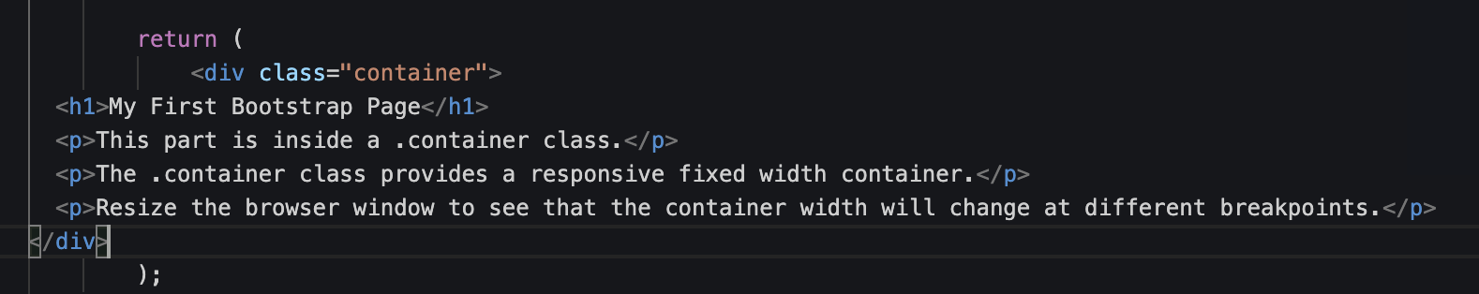
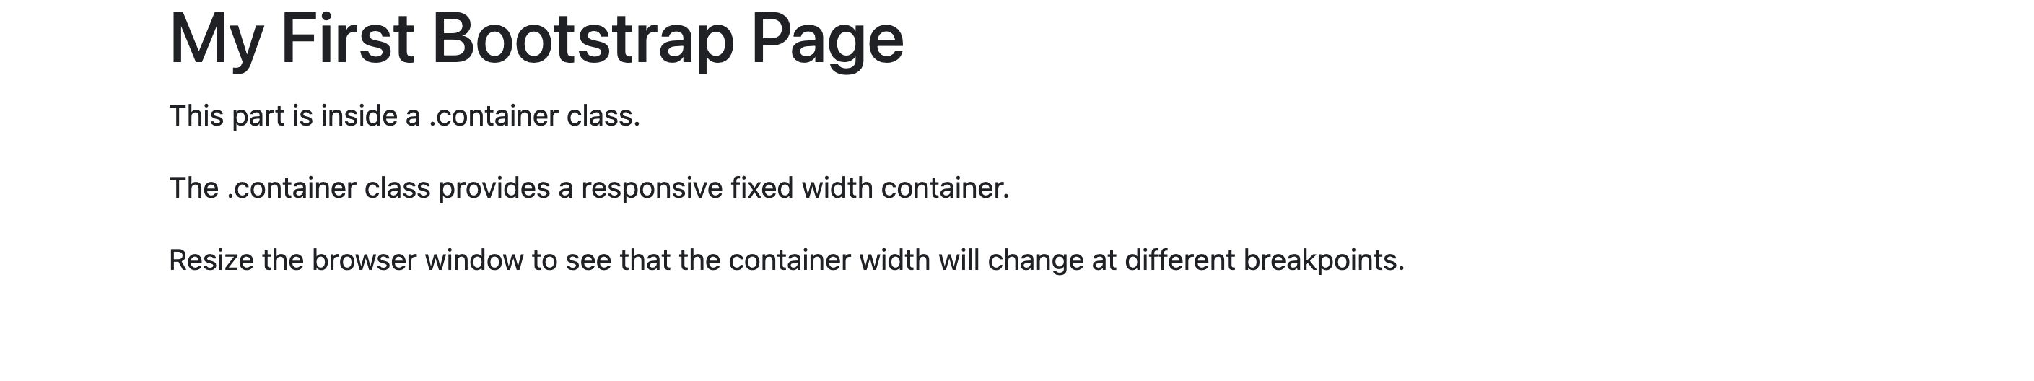
Bootstrap 5 Containers

Slide 12
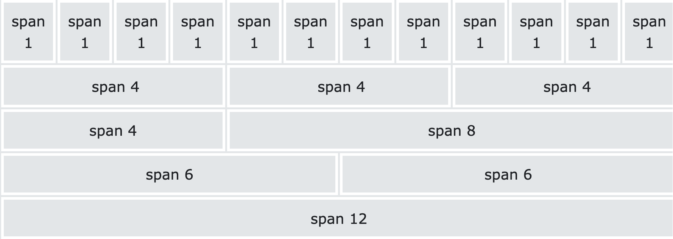
Bootstrap 5 Grid System
Bootstrap's grid system is built with flexbox and allows up to 12 columns across the page.
If you do not want to use all 12 columns individually, you can group the columns together to create wider columns
The grid system is responsive, and the columns will re-arrange automatically depending on the screen size.
Make sure that the sum adds up to 12 or fewer (it is not required that you use all 12 available columns)

Slide 13
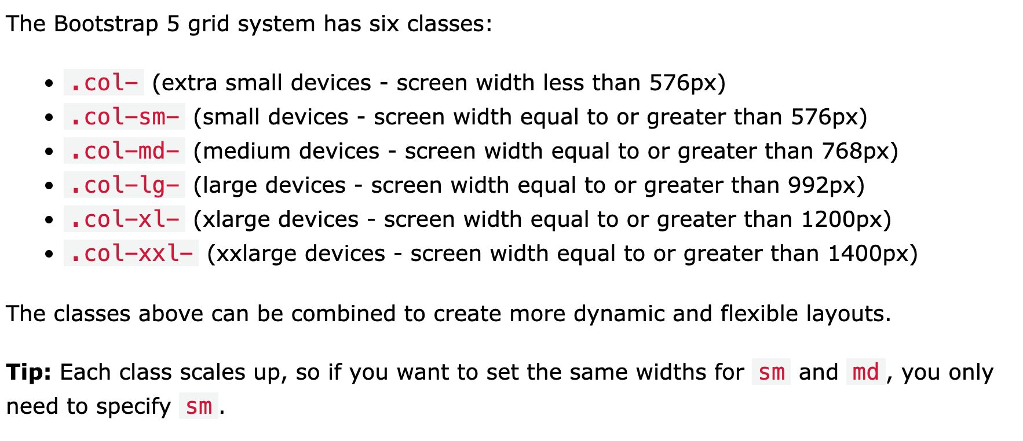
Grid Classes

Slide 14
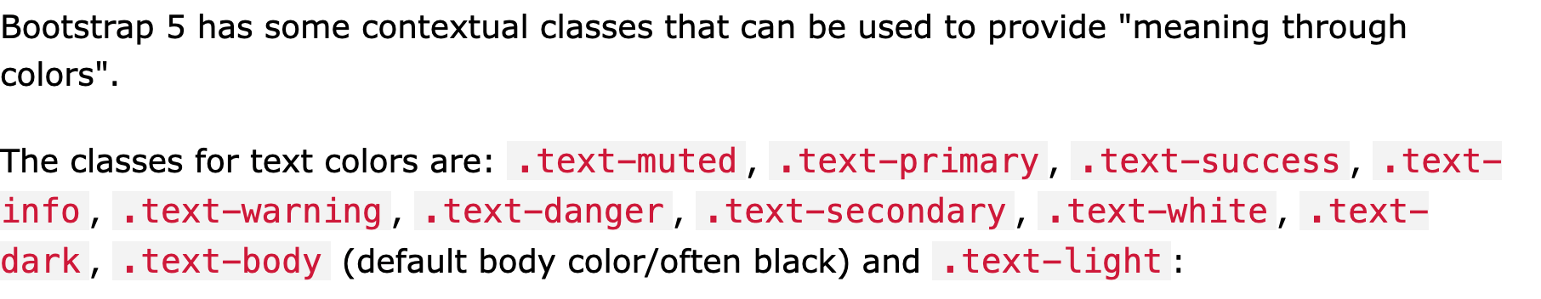
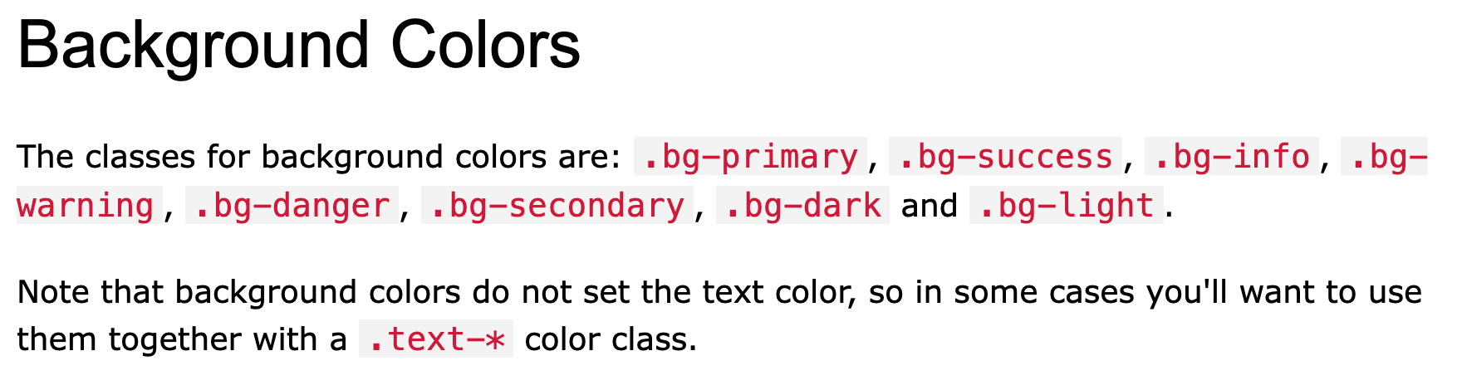
Bootstrap 5 Colors

Slide 15
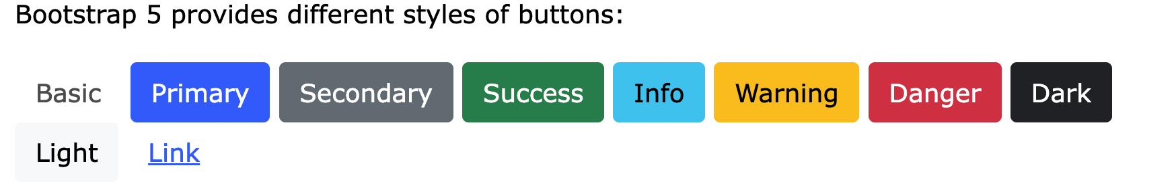
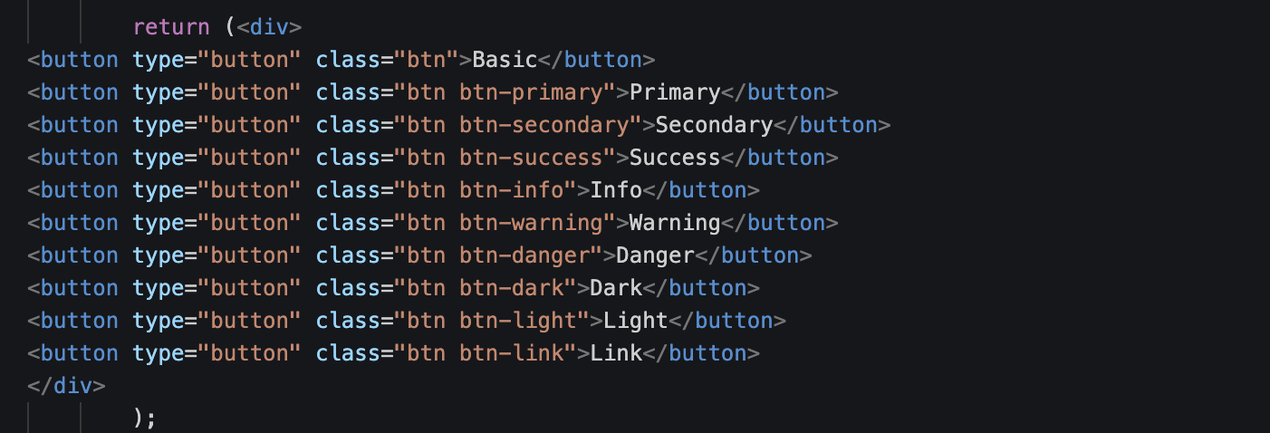
Bootstrap 5 Buttons

Slide 16
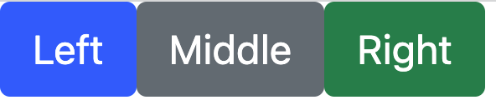
Using components button
export default function MyButton() {
return (
<div>
<Button >Left</Button>
<Button variant="secondary">Middle</Button>
<Button variant="success">Right</Button>
</div>
)
}
Use the variant API to apply complex styles to a component based on a single prop. This can be a handy way to support slight stylistic variations in button or typography components.
Import the variant function and pass variant style objects in your component definition. When defining variants inline, you can use Styled System like syntax to pick up values from your theme

Slide 17
Using Html Button
import 'bootstrap/dist/css/bootstrap.min.css';
export default function MyButton() {
return (
<div>
<button className='btn btn-info' >Left</button>
<button className="btn btn-secondary">Middle</button>
<button className="btn btn-success">Right</button>
</div>
)
}

Slide 18
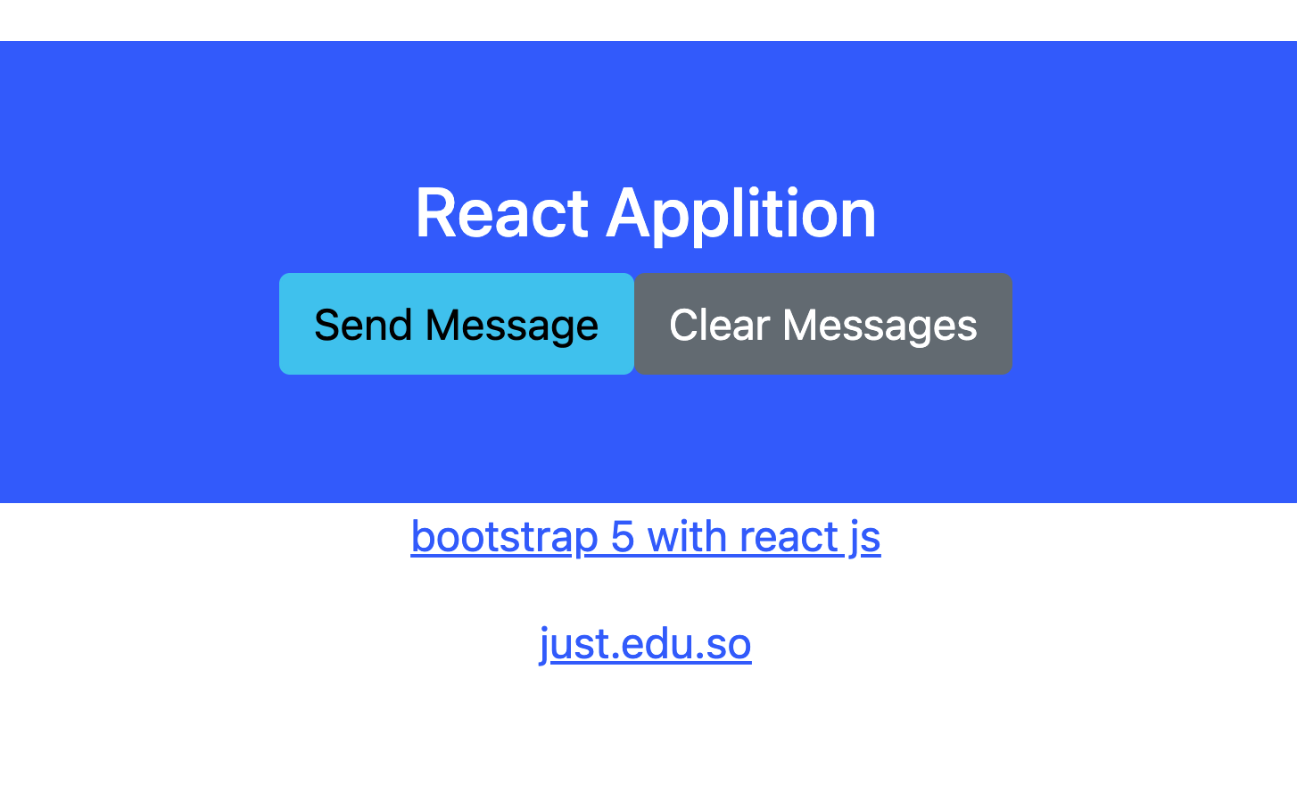
Bootstrap 5 Jumbotron

Slide 19
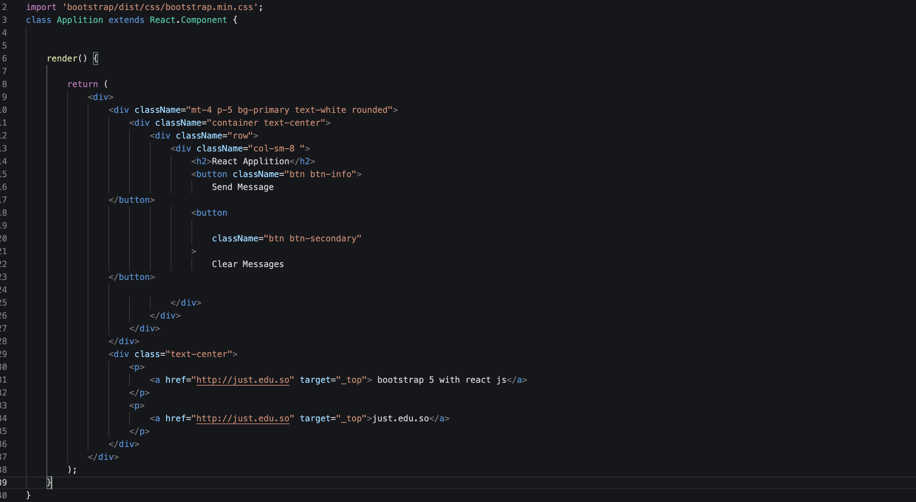

Slide 20
Using Html Button
import 'bootstrap/dist/css/bootstrap.min.css';
export default function MyButton() {
return (
<div>
<button className='btn btn-info' >Left</button>
<button className="btn btn-secondary">Middle</button>
<button className="btn btn-success">Right</button>
</div>
)
}

Slide 21
Bootstrap 5 Cards
A card in Bootstrap 5 is a bordered box with some padding around its content. It includes options for headers, footers, content, colors, etc.
Basic Card
A primary card is created with the .card class, and the content inside the card has a .card-body class
Header and Footer
The .card-header class adds a heading to the card and the .card-footer class adds a footer to the card

Slide 22
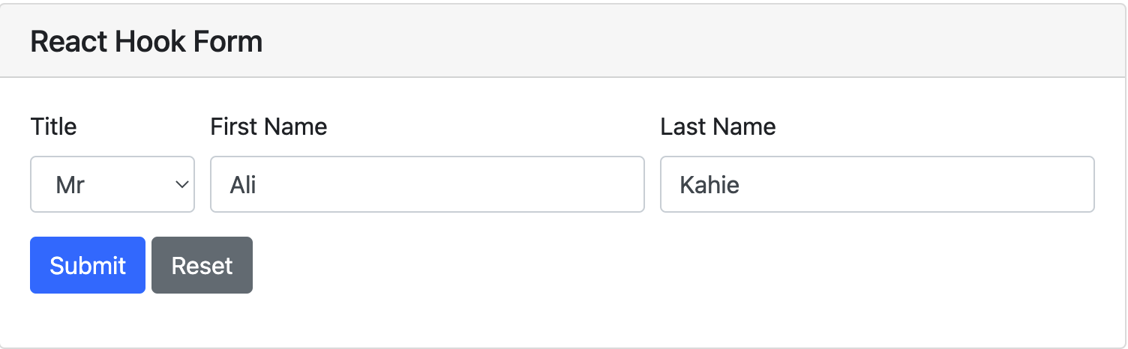
React Hook Form that loads user data into fields
This is an example React Hook Form with a few basic user fields to demonstrate loading data and setting form values after the React component is mounted with a couple of useEffect hooks

Slide 23
React Hook Form that loads user data into fields
This is an example React Hook Form with a few basic user fields to demonstrate loading data and setting form values after the React component is mounted with a couple of useEffect hooks

Slide 24
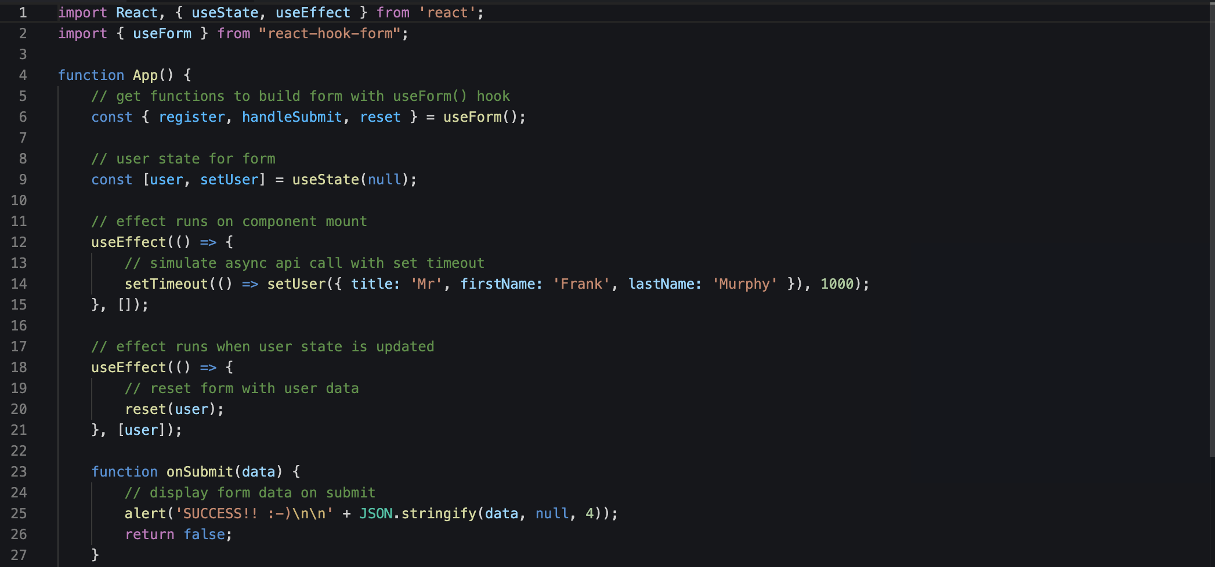
React Hook Form that loads user data into fields

Slide 25
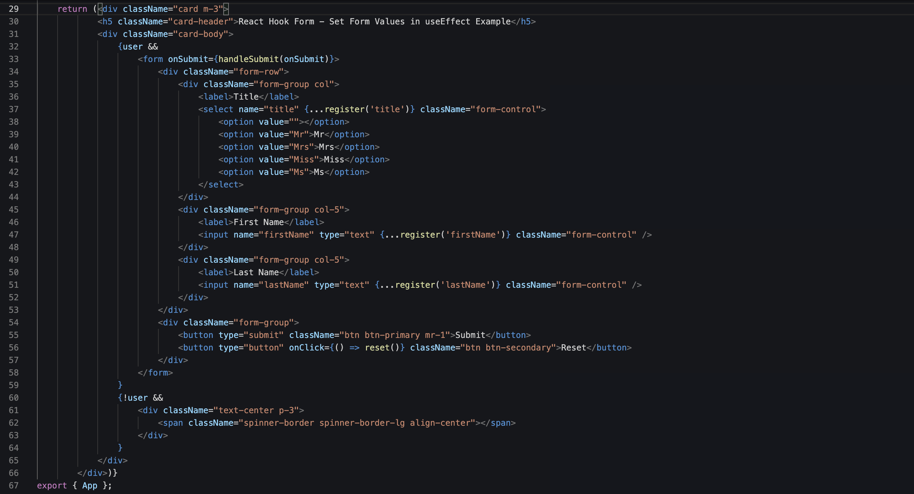

Slide 26
END.

